Slide 1
Data-Driven Diabetes Prediction: A Machine Learning Approach to Early Diagnosis
Cady Wilson

Slide 2

Research Question
Can lifestyle factors, alongside medical metrics, effectively predict whether an individual is likely to develop diabetes?

Slide 3
Can Lifestyle Choices Affect Diagnosis
Medical Indicators
Lifestyle Factors
Blood Sugar Levels
Cholesterol
Hypertension
A1C levels
Income
Education
Active lifestyle
Ability to afford healthcare

Slide 4
Stakeholders
Diabetics and Prediabetics
Broader Implications
Possibly identify and prevent cases in the future
Prevention over Intervention
Lessen the physical, psychological, and economic toll on diabetics and their families.
Healthcare systems could reallocate funds and resources to other causes.
Government funding and insurance companies would save money
Potentially saving taxpayer money or insurance costs

Slide 5

Data Used: Kaggle User Alex Teboul
Behavioral Risk Factor Surveillance System (BRFSS)
Health related telephone survey conducted annually by the CDC
Cleaned and preprocessed

Slide 6
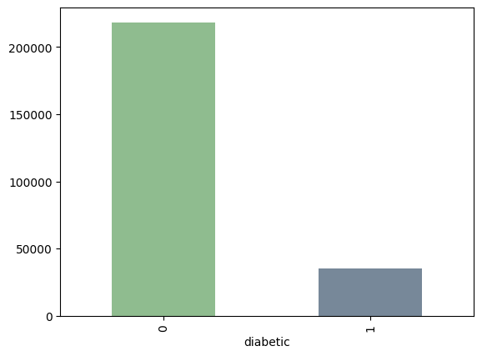
The Target: Identifying Diabetic Patients
Respondents Identifying as Diabetic
Respondents
Non-Diabetic = 0
Diabetic = 1
BRFSS is not specifically a diabetes study
The data is incredibly unbalanced, as over 5x the respondents do not have the disease

Slide 7
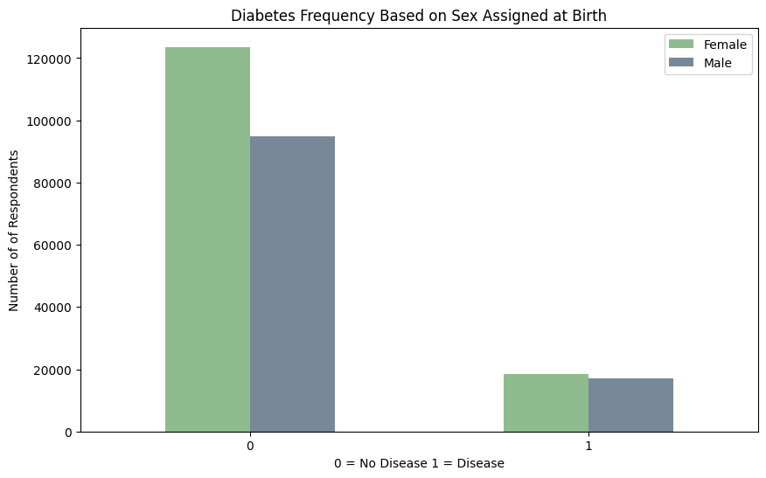
Sex Assigned at Birth and Diabetes

Slide 8
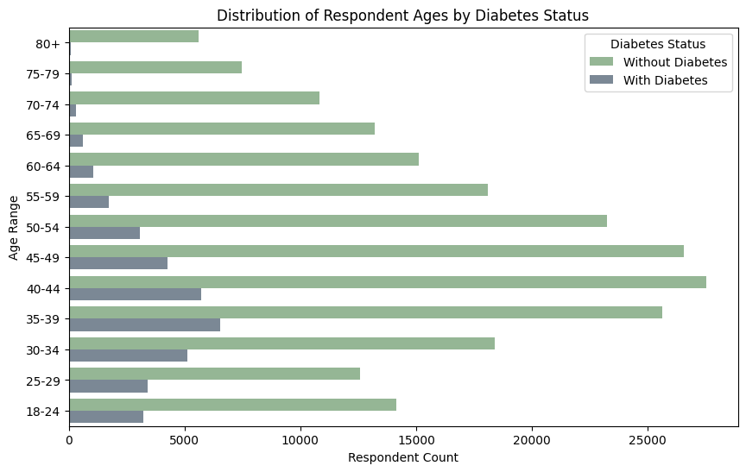
Age Range

Slide 9
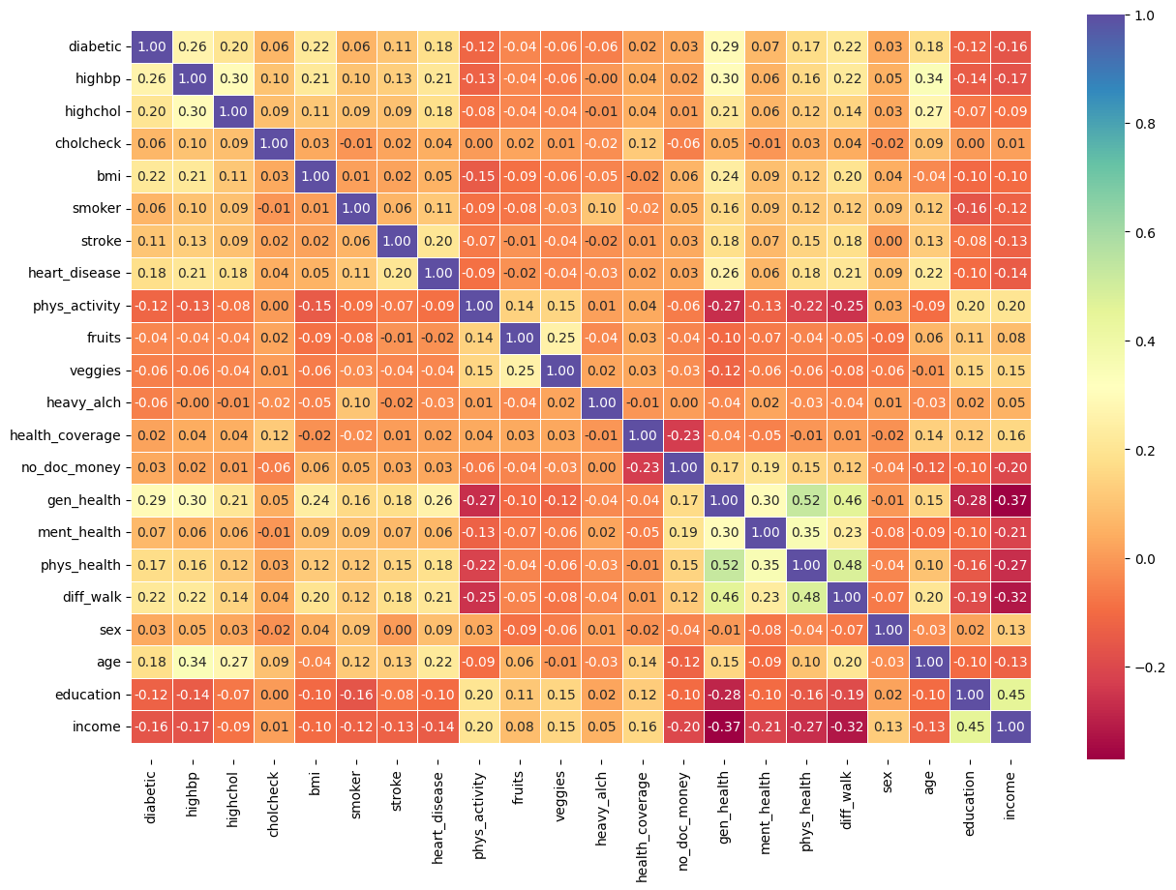
All Variables Compared

Slide 10
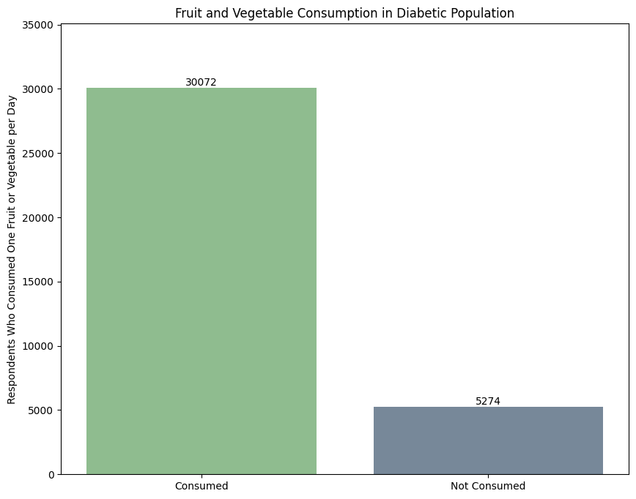
Confirmed Diabetic Data

Slide 11
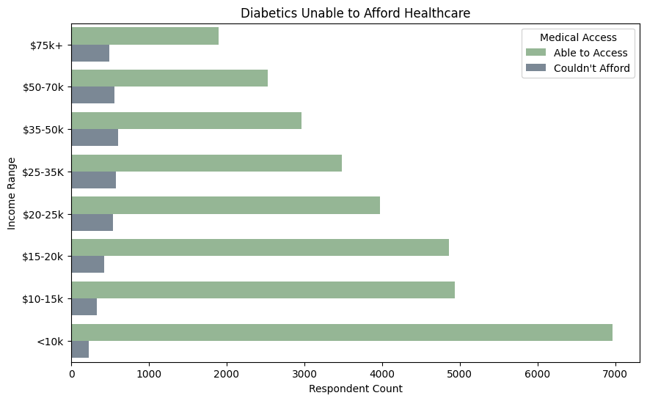
Healthcare Access
Fewer households make 75k a year. Presumably, these are multiple member households, without the assistance many can’t afford the exorbitant cost of healthcare.
Households making over $15-20k per year often lose eligibility for government assistance, such as disability benefits and government-funded healthcare
(https://www.ssa.gov/disability/eligibility)

Slide 12
Code Explanation
A look at the machine learning models chosen and trained for this project

Slide 13
Model Conclusion
While not as prominent as health metrics, we can see that some lifestyle factors do have an impact on diabetes status as well.

Slide 14
Recommendations
For The Model
For Medical Professionals
Refine the model by collecting more data
Retrain the model on the original, granular data
Perform the analysis on a machine capable of handling more processing needs
Implement a screening for at-risk patients using these criteria
Holistic Patient Assessment
Use Models for targeted prevention and intervention

